Slide 1
Presentation to
The MWRA Board of Directors
A Case for Green Certification
Lexi Dewey and Whitney Beals
Water Supply Citizens Advisory Committee
June 23, 2021

Slide 2
Why WSCAC recommends recertification
Enhancing trust, addressing reputational risk, acknowledgement of public interest in sustainability of forests and forest products.
There are public groups opposed to DCR forestry practices and have proposed legislation to restrict logging on all state lands.
The changing climate in New England requires working with a wider base of professional foresters, climate scientists, and new technologies to modify and improve forest management.

Slide 3
Benefits of recertification
Revitalizes the knowledge base of forest management by providing access to research and support from a wide range of forestry professionals.
Adds further credibility to the requirement to conduct forest management and avoid costly filtration.
Strengthens support from environmental groups, improves public understanding and confidence.
Establishes accountability for sustainable forest management.

Slide 4
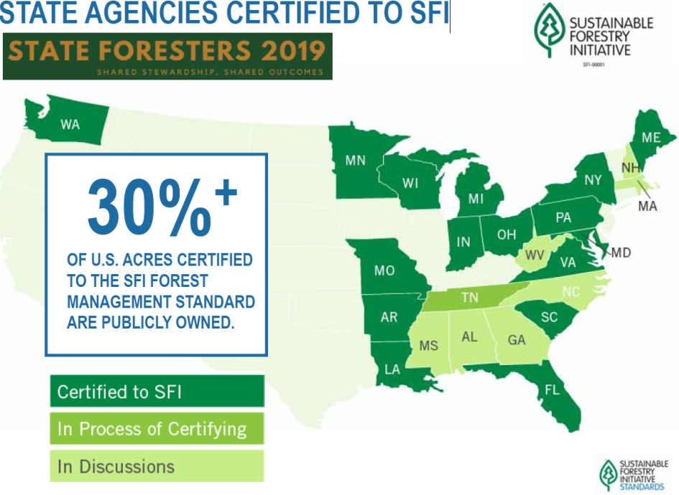
State Agencies certified to SFI
State agencies using SFI Certification in the Northeast
Maine Bureau of Parks and Lands
New York State Department of Environmental Conservation
Pennsylvania DCNR Bureau of Forestry

Slide 5
Role of public lands
Public lands can afford to set the standard for statewide forestry practices.
Appropriate scale for testing new equipment types, new ways of enhancing critical habitat or of overcoming landscape-scale problems (climate change, invasive species).
State lands should benefit from public reassurance via certification.
From a 2002 DCR presentation by Environmental Analyst Tom Kyker-Snowman
https://archives.lib.state.ma.us/bitstream/handle/2452/114312/ocn748285267.pdf?sequence=1&isAllowed=y

Slide 6
Concluding questions
~ From the same DCR presentation by Environmental Analyst Tom Kyker-Snowman
Has certification been worth the effort and cost?
YES
Has it resulted in positive changes in the management of state or private forests?
          YES

